Slide 1
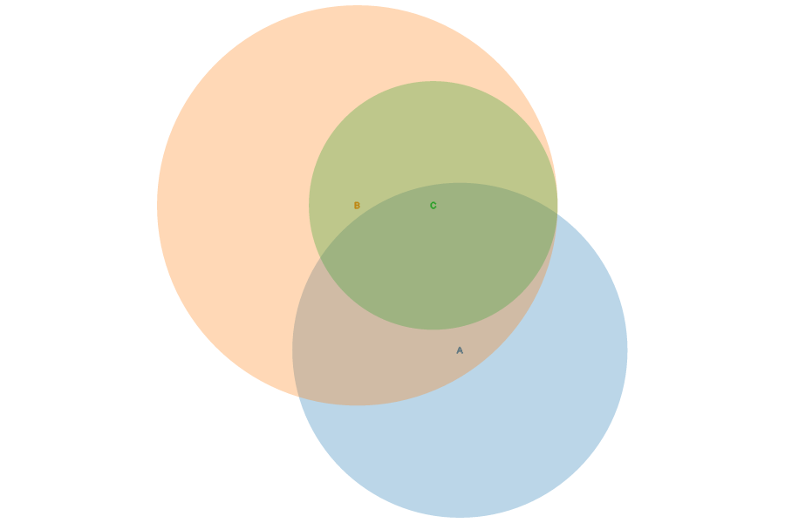
13
33
14
10
25
Comparison of differentially expressed bona fide miRNAs reported by Tahiri et al., 2014 (blue, n=49) and those identified as differentially expressed between normal breast tissue and DCIS in this study (red, n=70) with the proposed DCIS signature illustrated in green (n=27). Venn diagram generated by Academo (http://academo.org/demos/venn-diagram-generator/).

